Slide 1
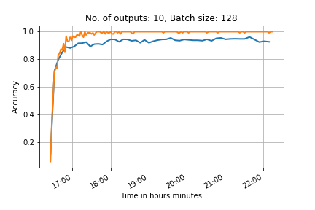
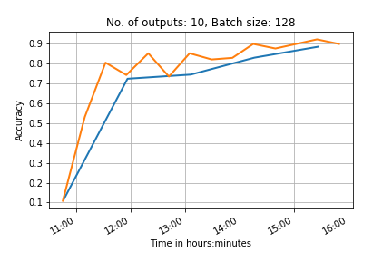
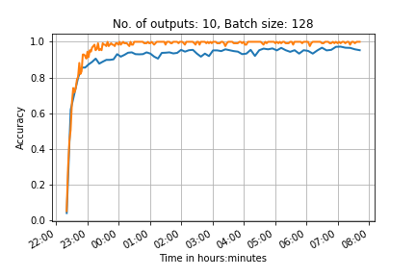
4 convolution layers
2 convolution layers, many outputs on each one
10 outputs
6 convolution layers

Slide 2
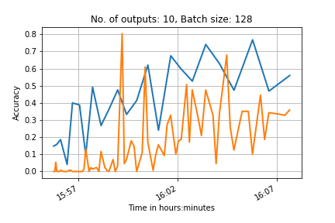
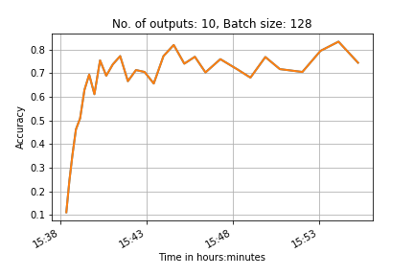
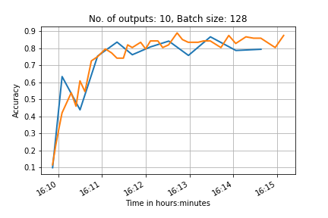
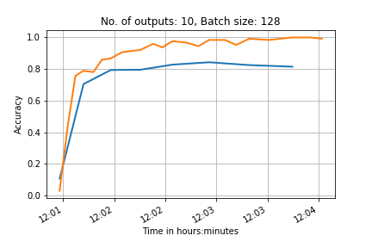
No shuffling
With shuffling
10 outputs,
Simple network
Normalised data
Advanced normalisation (and shuffled test data)

Slide 3
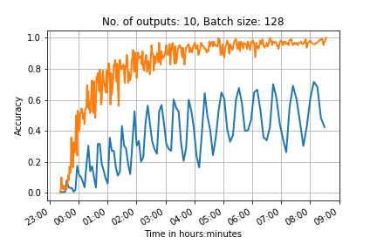
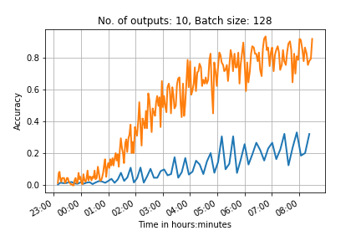
100 outputs
2 convolutional network, test batch 500
6 convolutional network test batch 1000
0.95(*10000) steps
0.65(*10000) steps
Learning rate too high?
Increase the drop out layer to prevent overfitting to the training data?
If we compare this to the previous network we expect it to have a testing accuracy of ~0.5 when it ends

Slide 4
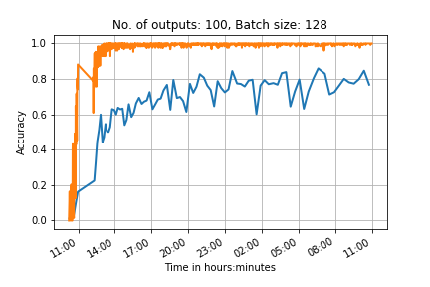
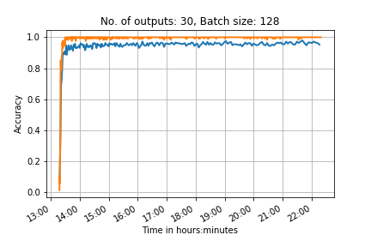
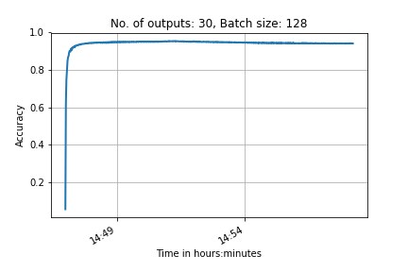
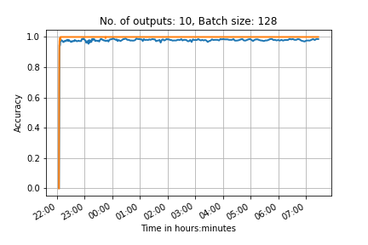
PRINT
CNN with 2 Convolutional layers and 2 fully connected layers
Transfer

Slide 5
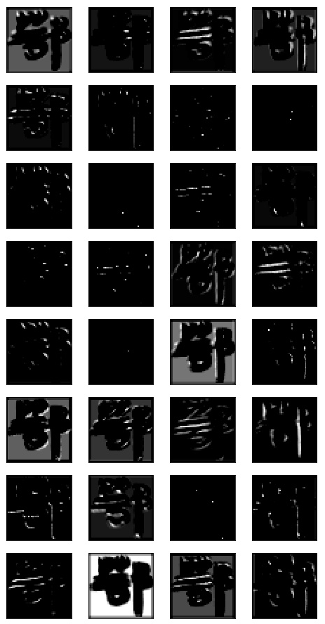
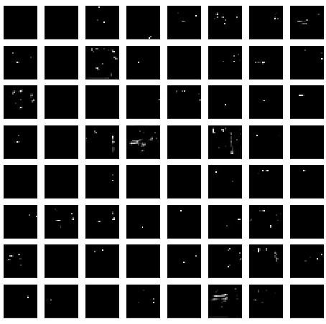
1st layer activations
2nd layer activations
Feature maps from convolutional layers from network trained on 100 classes from scratch
PRINT

Slide 6
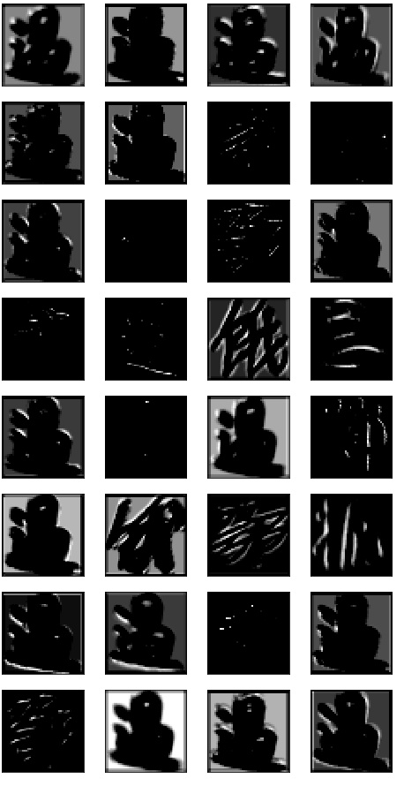
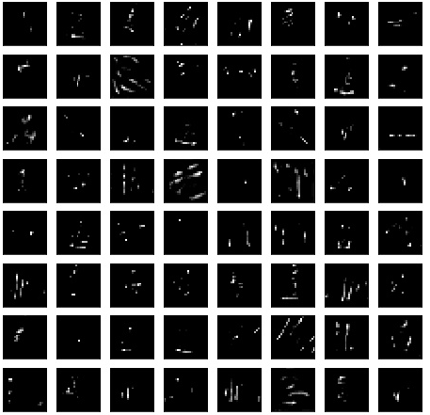
Feature maps – maximum activation
1st layer activations
2nd layer activations
Feature maps from convolutional layers from network trained on 100 classes from scratch

Slide 7
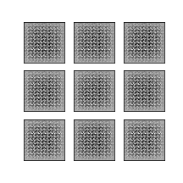
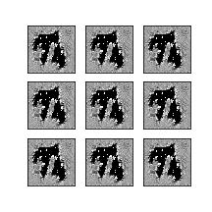
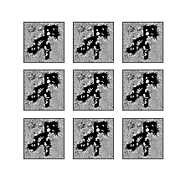
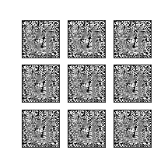
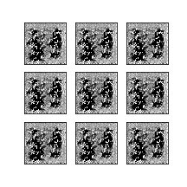
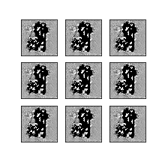
GAN

Slide 8
References
Feature maps
https://arxiv.org/pdf/1507.02313.pdf
Transfer learning
https://papers.nips.cc/paper/5347-how-transferable-are-features-in-deep-neural-networks.pdf
Notes on online deep learning course
https://arxiv.org/pdf/1507.02313.pdf
GANs:
Overview of GANs: https://arxiv.org/pdf/1710.07035.pdf
Face aging with cGAN: https://arxiv.org/pdf/1702.01983.pdf
Image de-raining with cGAN: https://arxiv.org/pdf/1701.05957.pdf
Original GAN paper: http://papers.nips.cc/paper/5423-generative-adversarial-nets.pdf
DC-GAN paper: https://arxiv.org/pdf/1511.06434.pdf
ALI (Adversarially learned inference) model: https://arxiv.org/pdf/1606.00704.pdf
BiGAN (same as ALI): https://arxiv.org/pdf/1605.09782.pdf

